Slide 1
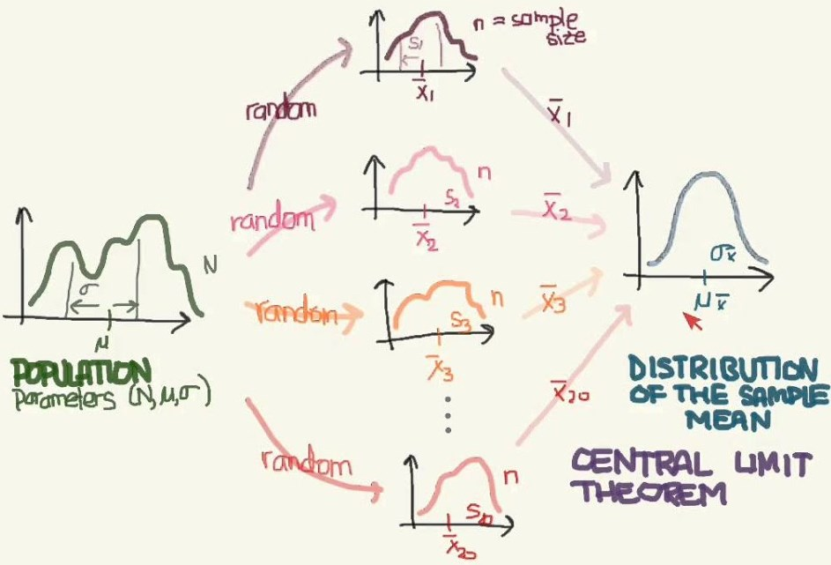
Central Limit Theorem
Dr. Abolfazl Saghafi
Assistant Professor of Statistics & Data Science
Data Science Program Director
Chapter 5 Part 2

Slide 2
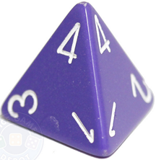
CLT
A fair die with four sides numbered from 1 to 4 is tossed once.
Let X1 register the appeared number. Identify the probability distribution of X1, Compute its mean and variance.
prob
Sum
1/4
1
2
3
4

Slide 3
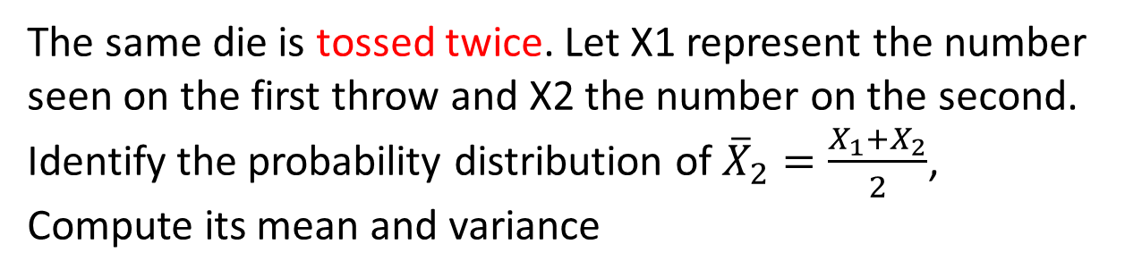
CLT
The same die is tossed twice. Let X1 represent the number seen on the first throw and X2 the number on the second. Identify the probability distribution of ${\overline{X}}_{2}=\frac{X_{1}+X_{2}}{2}$, Compute its mean and variance
prob
1/4
Sum
1/16
1
2
3
4

Slide 4
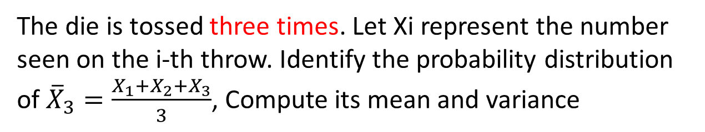
CLT
The die is tossed three times. Let Xi represent the number seen on the i-th throw. Identify the probability distribution of ${\overline{X}}_{3}=\frac{X_{1}+X_{2}+X_{3}}{3}$, Compute its mean and variance
Sum
prob
3/16
1/64
1
2
3
4

Slide 5
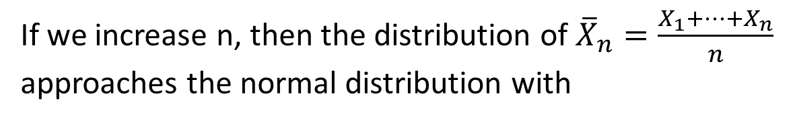
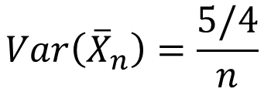

CLT
If we increase n, then the distribution of ${\overline{X}}_{n}=\frac{X_{1}+…+X_{n}}{n}$
approaches the normal distribution with
$$E\left({\overline{X}}_{n}\right)=2.5$$
$$Var\left({\overline{X}}_{n}\right)=\frac{5/4}{n}$$
prob
This is generally true for any basic distribution for Xi and is known as Central Limit Theorem
3/16
1/64
1
2
3
4
Notes:
http://blog.minitab.com/blog/michelle-paret/explaining-the-central-limit-theorem-with-bunnies-and-dragons-v2

Slide 6
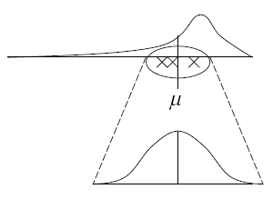
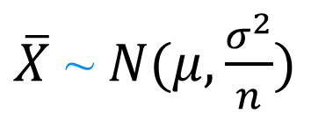
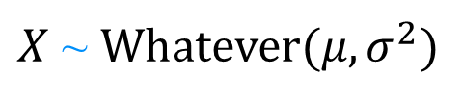
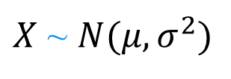
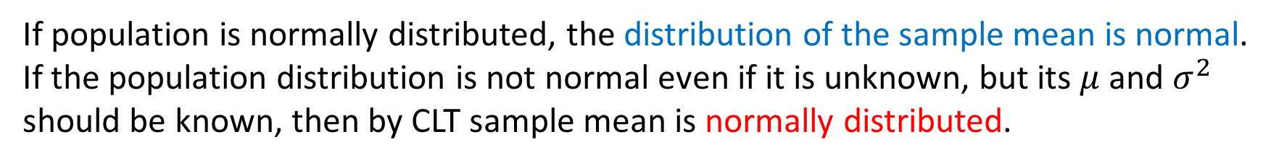
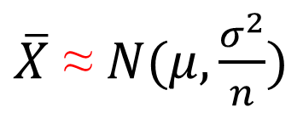
Summary
$X$ ~ $N(μ,σ^{2})$
$X$ ~ $Whatever(μ,σ^{2})$
$\overline{X}$ ~ $N(μ,\frac{σ^{2}}{n})$
$\overline{X}$ ≈ $N(μ,\frac{σ^{2}}{n})$
If population is normally distributed, the distribution of the sample mean is normal. If the population distribution is not normal even if it is unknown, but its $μ$ and $σ^{2}$ should be known, then by CLT sample mean is normally distributed.

Slide 7
Example
The given histogram shows the distribution of grades for the second ST 310 test among 150 students.
Suppose we know that the population mean is μ = 76 with a standard deviation of σ = 8.
μ = 76
σ = 8
a) What is the probability that a sample of 16 students have an average grade between 80 and 84?
b) What is the probability that a sample of 25 students have an average grade between 80 and 84?
c) What is your conclusion from part a and b?
Distribution is Unknown
Notes:
https://anilz.shinyapps.io/Central_Limit_Theorem/

Slide 8
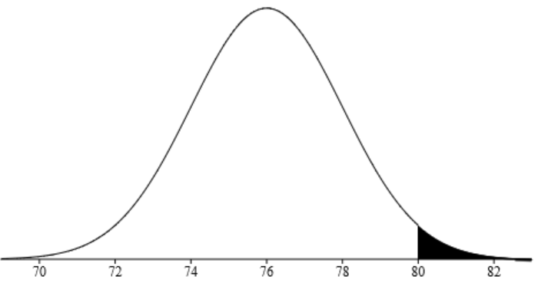
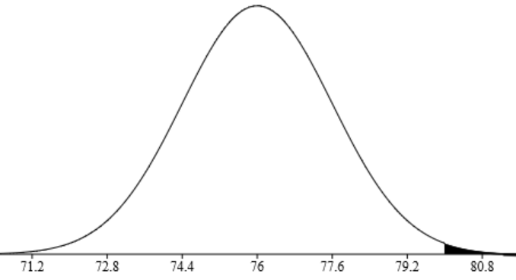
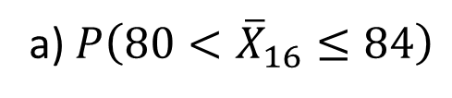
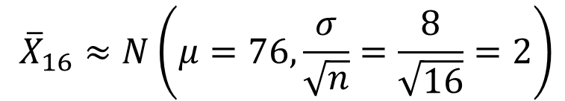


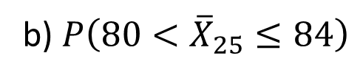

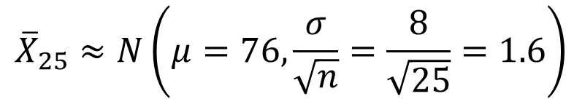

RV $X$: ST 310 test grades
$$\sim ?\left(μ=76, σ=8\right)$$
$${\overline{X}}_{16}≈N\left(μ=76,\frac{σ}{\sqrt{n}}=\frac{8}{\sqrt{16}}=2\right)$$
Average grade of 16 students
a) $P\left({80<\overline{X}}_{16}≤84\right)$
$$=normalcdf\left(80, 84, 76, 2\right)=0.0228$$
$${\overline{X}}_{25}≈N\left(μ=76,\frac{σ}{\sqrt{n}}=\frac{8}{\sqrt{25}}=1.6\right)$$
Average grade of 25 students
b) $P\left({80<\overline{X}}_{25}≤84\right)$
$$=normalcdf\left(80, 84, 76, 1.6\right)=0.0062$$
c) Conclusion:
Notes:
Conclusion: By increasing the sample, distribution of sample mean becomes more humpy

Slide 9
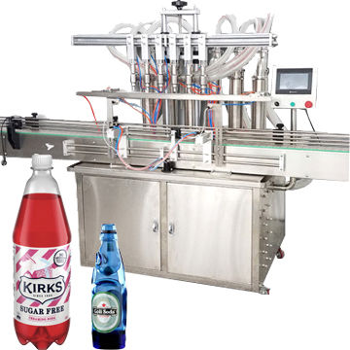
Example
A soda filling machine is designed to fill soda bottles normally with an average of 16 ounces and standard deviation of 1 ounce.
a) A bottle of soda is selected randomly after it is being filled, what is the probability that it has more than 18 ounce of soda?
b) If we select 25 bottles of soda at random, what is the probability that their average is at most 15.5 ounce?
c) What percentage of the bottles have soda between 14 and 18 ounces?
d) How many in daily work of 10,000 bottles have soda between 14 and 18?
e) Determine value of “c” such that 95% of the bottles are filled up to “c” ounce.

Slide 10
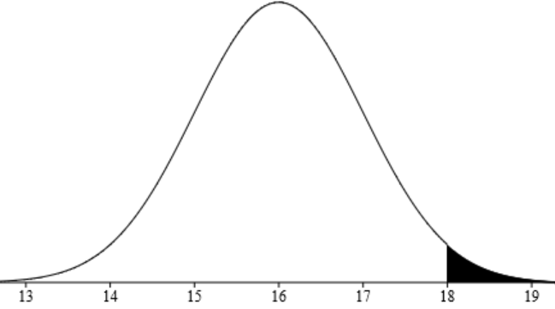
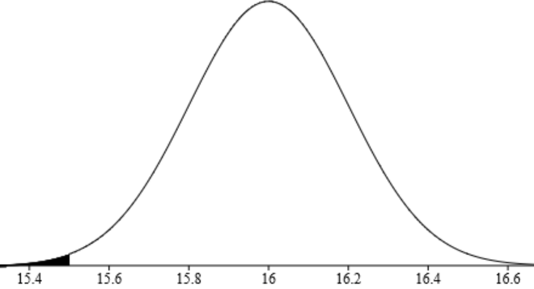

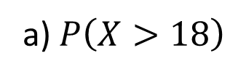


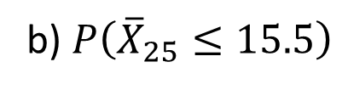


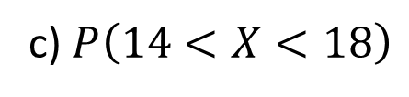
RV $X$: The amount of soda in EACH bottle
$$\sim N\left(μ=16, σ=1\right)$$
a) $P\left(X>18\right)$
$$=normalcdf\left(18,∞, 16, 1\right)=0.0228$$
Average of soda in 25 bottles
$${\overline{X}}_{25}\sim N\left(μ=16, σ/\sqrt{25}=0.2\right)$$
b) $P\left({\overline{X}}_{25}≤15.5\right)$
$$=normalcdf\left(−∞,15.5, 16, 0.2\right)=0.0062$$
c) $P\left(14<X<18\right)$
$$=normalcdf\left(14, 18, 16, 1\right)=0.9544$$
→ 95.44%

Slide 11
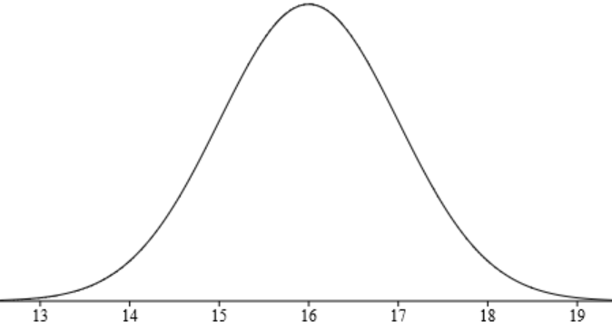
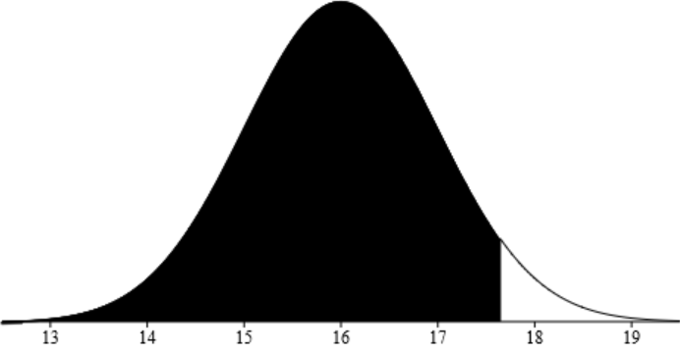

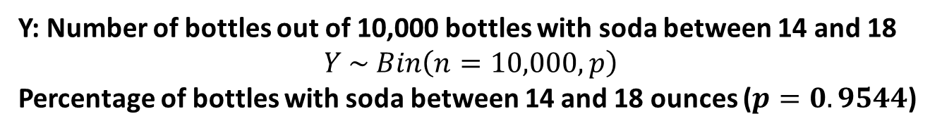
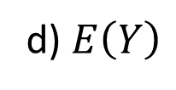


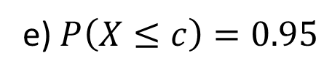

Y: Number of bottles out of 10,000 bottles with soda between 14 and 18
$$Y \sim Bin\left(n=10,000, p\right)$$
Percentage of bottles with soda between 14 and 18 ounces ($p=0.9544$)
d) $E\left(Y\right)$
$$=np=10,000∗0.9544=9544$$
bottles
RV $X$: The amount of soda in EACH bottle
$$\sim N\left(μ=16, σ=1\right)$$
95% of the bottles are filled up to “c” ounce
e) $P\left(X≤c\right)=0.95$
$$⇒c=invNorm\left(0.95, 16, 1\right)=17.645$$
oz
$$c=17.645$$

Slide 12
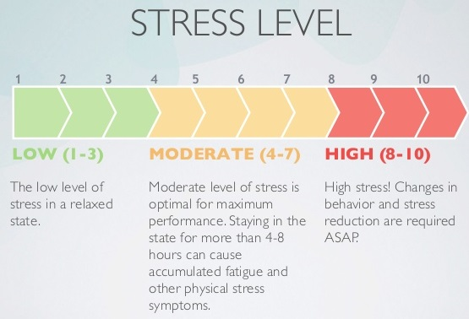
Example
A study regarding stress is done on a college campus among students. The stress scores follow a uniform distribution with the lowest stress score equal to 1 and the highest equal to 10 with mean of 5.5 and standard deviation 1.16. Using a sample of 15 students, find:
a) the probability that the average stress score for the 15 students is less than 5.
b) the probability that the total of the 15 stress scores is less than 90.
c) What’s your conclusion if the summation of stress scores for 15 students is greater than 130?

Slide 13
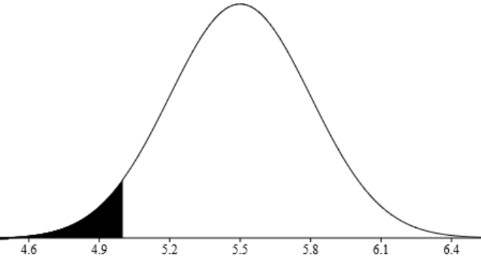
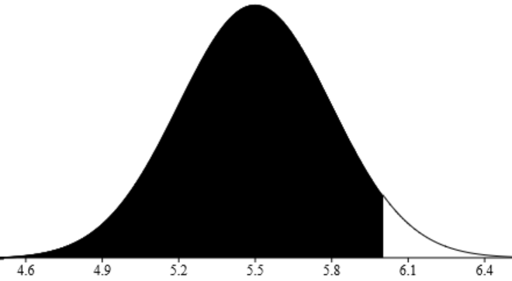

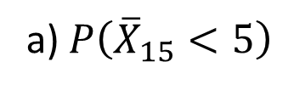
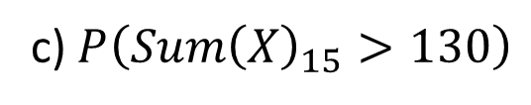




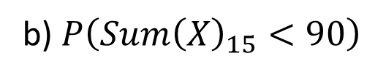
RV $X$: The stress score
$$\sim ?\left(μ=5.5, σ=1.16\right)$$
Average of 75 stress scores
$${\overline{X}}_{15}≈ N\left(μ=5.5, σ/\sqrt{15}=0.3\right)$$
a) $P\left({\overline{X}}_{15}<5\right)$
$$=normalcdf\left(−∞,5, 5.5, 0.3\right)=0.0475$$
b) $P\left({Sum\left(X\right)}_{15}<90\right)$
$$=P\left({\overline{X}}_{15}<90/15\right)=P\left({\overline{X}}_{15}<6\right)$$
$$=normalcdf\left(−∞,1.67, 5.5, 0.3\right)=0.9525$$
c) $P\left({Sum\left(X\right)}_{15}>130\right)$
$$=P\left({\overline{X}}_{15}>8.67\right)=normalcdf\left(8.67, ∞, 5.5, 0.3\right)$$
$$≈0.000$$
The students are SUPER stressed, they need help

Slide 14

Practice Problems Part 2
1. A can of salmon have a nominal net weight of 418 g. However, due to variation in the canning process, the actual net weight has an approximate normal distribution with a mean of 420 g and a standard deviation of 10 g. According to Consumer Affairs, a sample of 16 cans should have less than a 5% chance that the average weight is less than 418 g. What is the actual probability that a sample of 16 cans will have a mean weight less than 418 g? What is the probability that one can has a weight less than 418 g?
2. The time required to assemble an electronic component is normally distributed with a mean of 12 minutes and a standard deviation of 1.5 min. Find the probability that the average time required to assemble nine components is greater than 13 minutes.
Notes:
Answers are provided in Ch5 Practice Problem Solutions.

Slide 15

Funny AH
Notes:
Answers are provided in Ch5 Practice Problem Solutions.

Slide 16
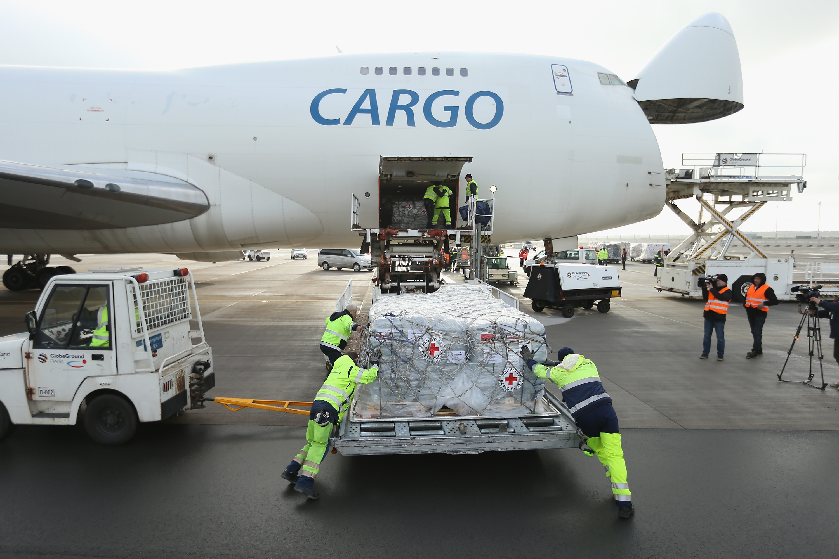
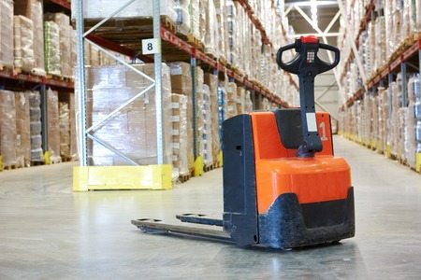
Practice Problems Part 2
3. Government regulations indicate that the total weight of cargo in a certain kind of airplane cannot exceed 330 kg. On a particular day a plane is loaded with 100 boxes of goods. If the weight distribution for individual boxes is normal with mean 3.2 kg and standard deviation 0.7 kg, compute the probability that the regulations will NOT be met.
4. A wholesale distributor has found that the amount of a customer’s order is a normal random variable with a mean of $200 and a standard deviation of $50. What is the probability that the average amount in a random sample of 20 orders is between $170 and $225?
Notes:
Answers are provided in Ch5 Practice Problem Solutions.
http://onlinestatbook.com/2/sampling_distributions/clt_demo.html

